Slide 1
REPORT SERVER Jaspersoft
Service Desk
11-Oct-19

Slide 2
REPORT SERVER
INTENDED USE
Extract data from Suite / Pandora based upon predesigned Reports
Share extracted tables/reports
SOLUTION
JasperSoft Report Server
TABLE OF CONTENTS OF THIS GUIDANCE
Login
Visualize Reports
Request Scheduled Report

Slide 3
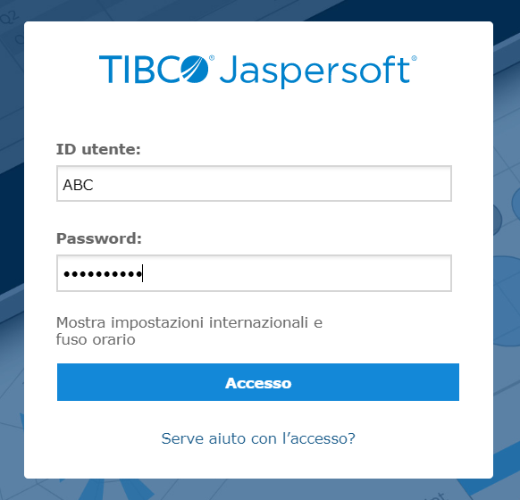
HOW TO LOGIN
Login
Go to jrs.pqegroup.com and insert your corporate acronym and password.
OR click on the link included in the Suite page
Mettete immagine del link su Suite

Slide 4
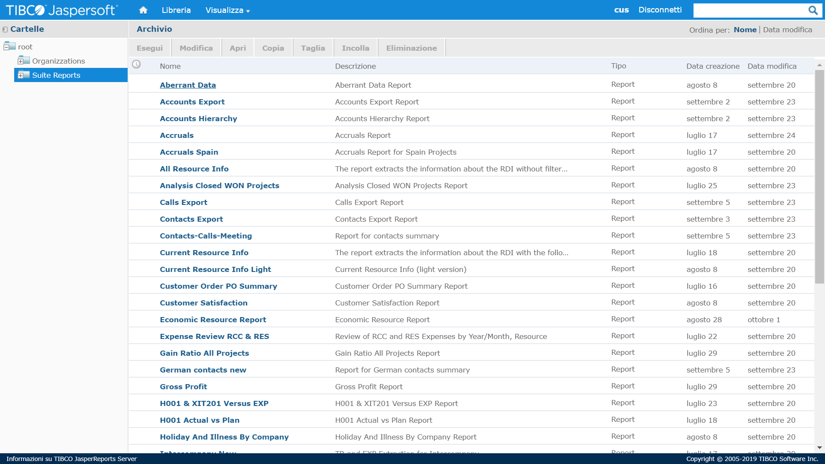
HOW TO EXECUTE REPORTS
Step 1. Visualize Reports (The Suite Reports folder shows all the reports you have access to)
If the report you need is not included in the list, you may be not allowed to run. Contact Service Desk

Slide 5
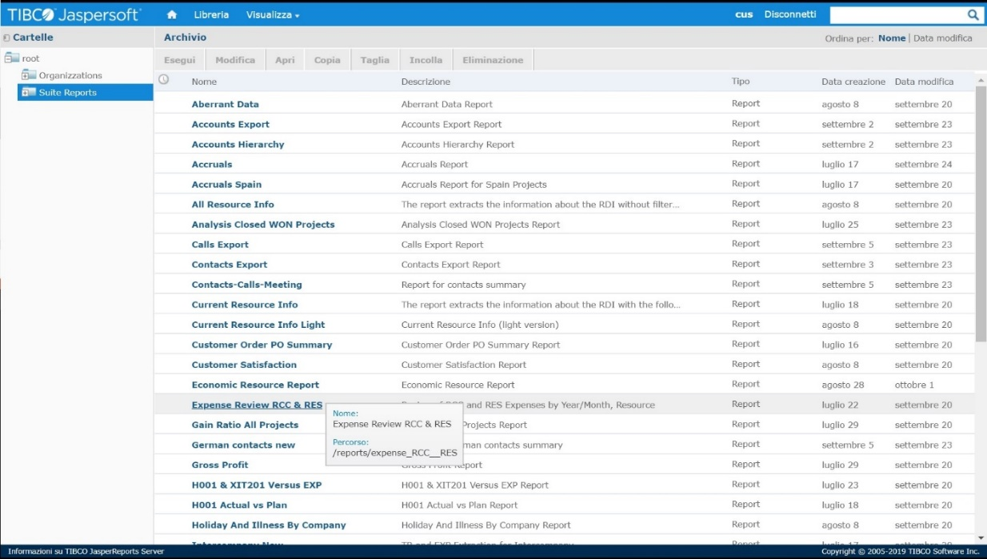
HOW TO EXECUTE REPORTS
Step 2. Visualize Reports (Click the name of the report you want to run)

Slide 6
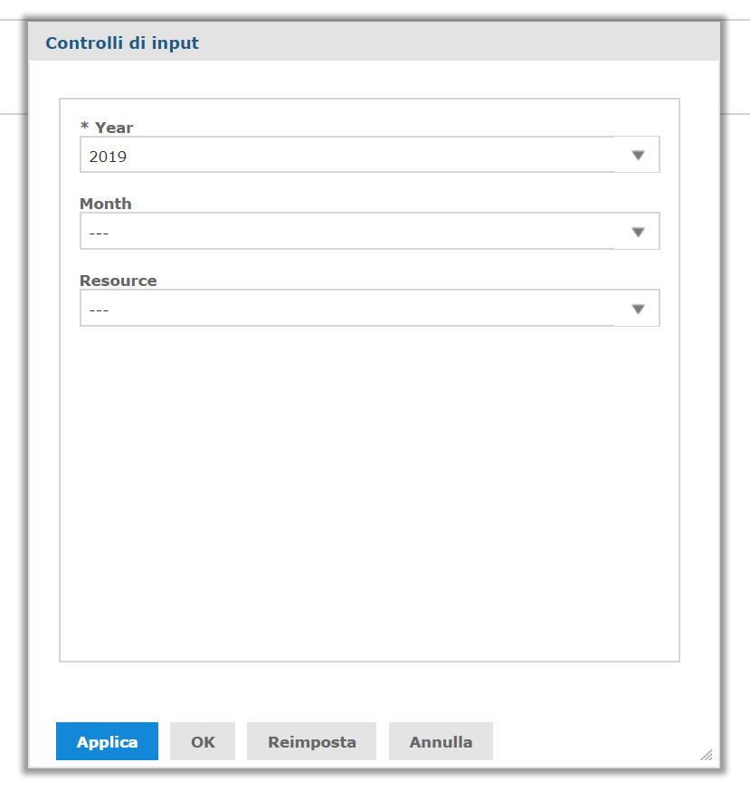
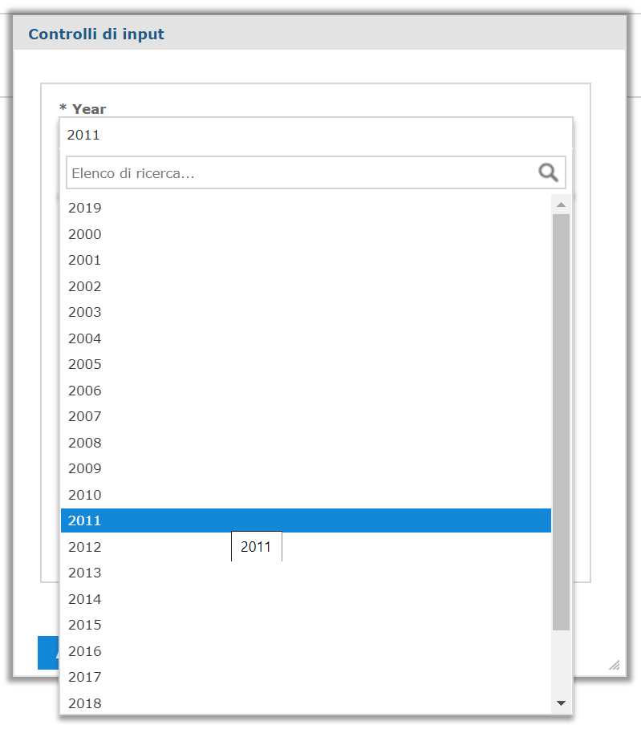
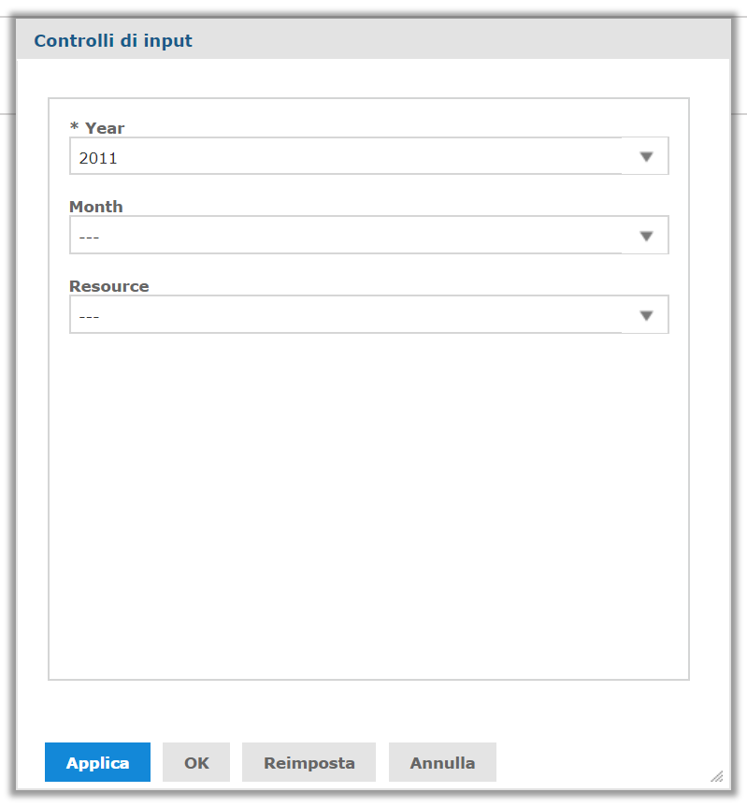
HOW TO EXECUTE REPORTS
Step 3. Fill out the report parameters
If required to filter data to be included in the report, a filter mask will be displayed.
Fields associated with an asterisk are required.
Click OK after selecting your choices)

Slide 7
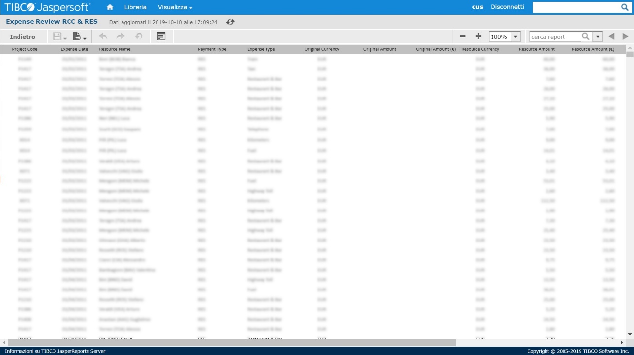
HOW TO EXECUTE REPORTS
Step 4 Report output is reported in the webpage

Slide 8
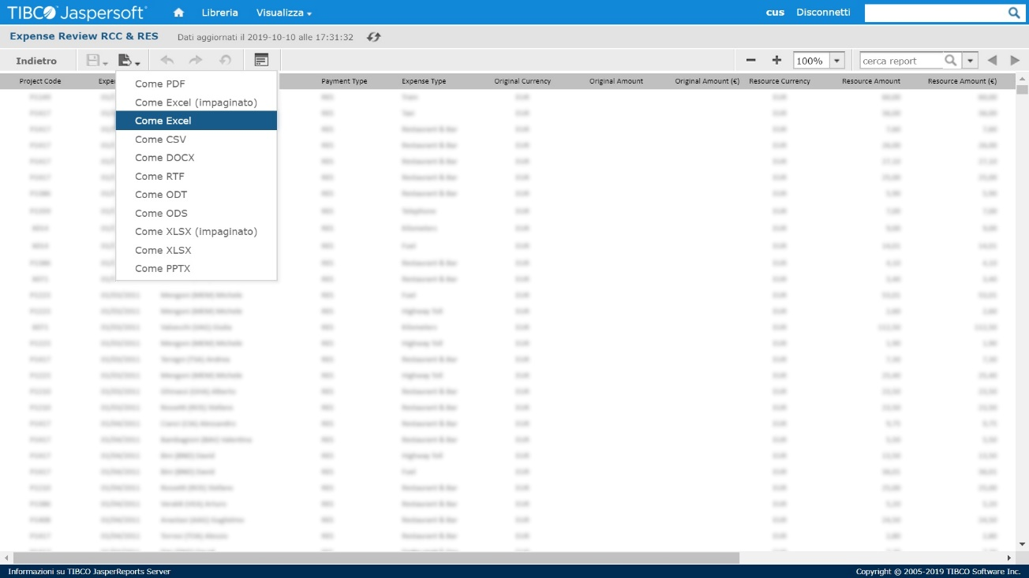
EXPORT REPORT OUTPUT
Export Reports
Generated reports can be exported to your desktop through the Export icon.

Slide 9
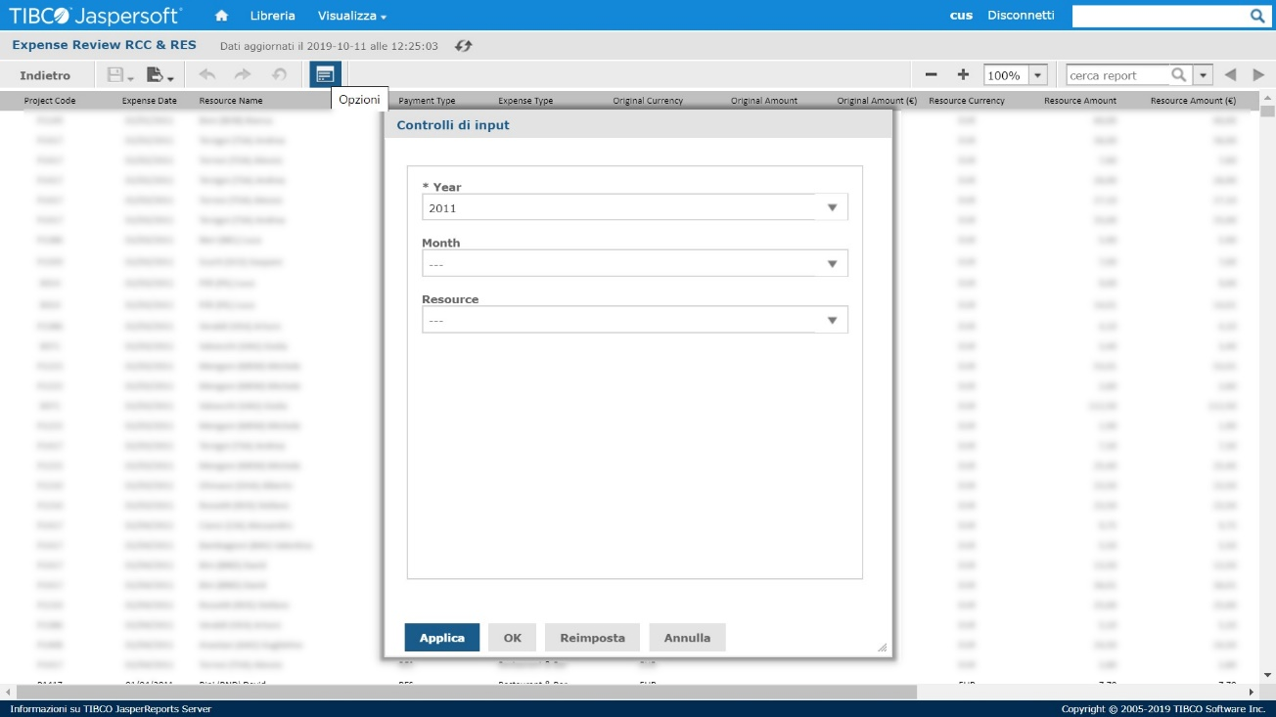
EXPORT REPORT OUTPUT
Filter Report output
If needed, you can modify the visualized report choosing different filters through the Options icon

Slide 10
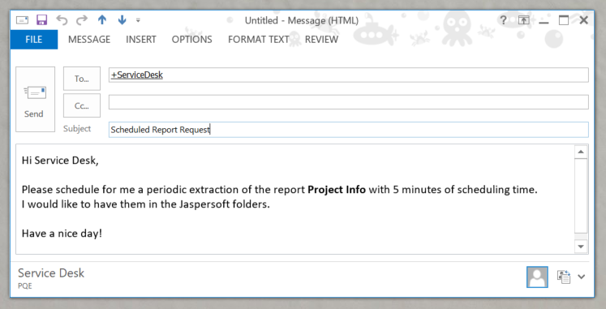
SCHEDULED REPORT REQUEST
Request Scheduled Report
You can ask Service Desk to schedule reports for you. Send your request to servicedesk@pqegroup.com, specifying the name of the report, the scheduling time and if the result should be delivered to the Jaspersoft subfolders, to your email address, or both.

Slide 11
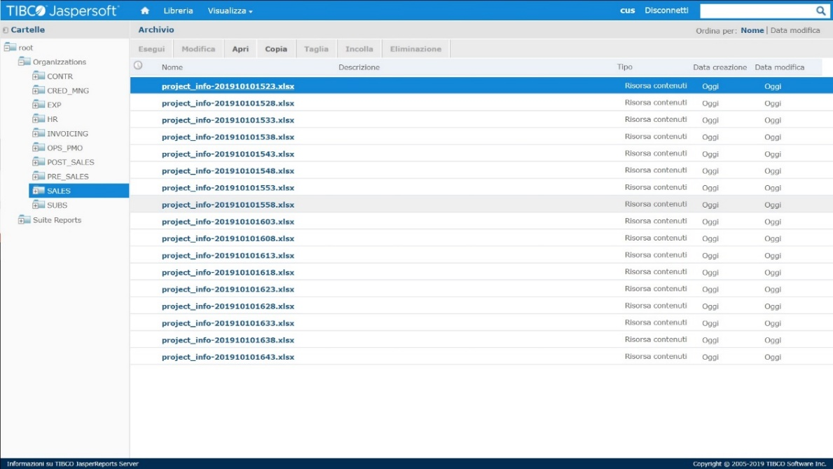
SCHEDULED REPORT REQUEST
Request Scheduled Report
If you ask to see results in Jaspersoft, scheduled reports will be soon available in the Organizations subfolders, depending on your business area.

